Slide 1

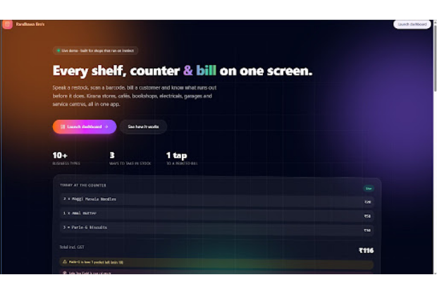
HACKATHON PROJECT SHOWCASE
Amrit Randhawa & Tranpreet Randhawa
Randhawa Bro's Inventory
Every shelf, counter, and bill on one unified screen.
POWERED BY GEMINI 4 ARGON · GPT 6 LUNA · CLAUDE 5.5 SONNET

Slide 2
01 / THE PROBLEM
Why Small Business Stock Fails
Legacy Spreadsheets
Counter-First Reality
Slow Data Entry: Manual typing blocks busy shop counters.
Hands-Free Speed: Restock items instantly using voice commands.
Blind Stockouts: Zero early alerts for expiring goods.
Proactive Warnings: Automated low-stock and expiry tracking.
Rigid Templates: Built for accountants rather than shopkeepers.
Tailored Workflows: Presets for kiranas, cafes, and bookshops.
Disconnected Bills: Separate tools for stock and invoicing.
Unified Billing: Instant GST invoices deduct stock automatically.

Slide 3

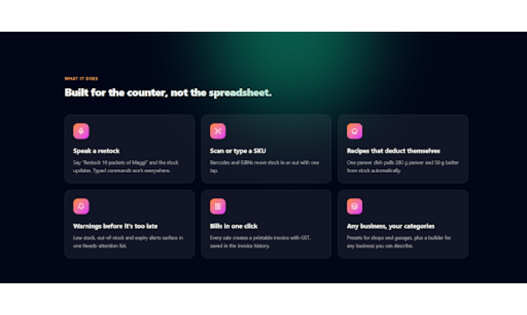
02 / THE SOLUTION
Built for the Counter, Not the Spreadsheet
Voice & Barcode Input
Speak restock updates or scan SKUs in one tap.
Auto-Deducting Recipes
Every dish sold pulls raw ingredients from stock.
One-Click GST Bills
Generate printable customer invoices on every sale.

Slide 4
03 / PLATFORM SCALE
Zero Friction from Day One
3 Ways
10+
1 Tap
<60s
Business Presets
Instant Billing
Store Setup
Ready-to-use industry templates.
Printable GST customer invoices.
No staff training required.
Stock Intake
Voice, barcode scan, or CSV.

Slide 5

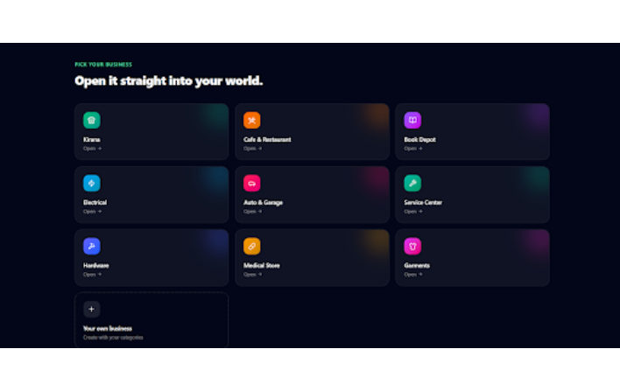
04 / MULTI-CATEGORY ENGINE
Open Straight Into Your World
Tailored workflows for every neighborhood business:
Kirana & Medical: Expiry-first shelf alerts.
Cafe & Restaurant: Ingredient recipe deduction.
Book Depot: ISBN barcode catalogue.
Electrical & Hardware: Brand SKU tracking.
Custom Builder: Define custom categories.

Slide 6


05 / SEAMLESS WORKFLOW
Three Steps. No Training Needed.
STEP 01
STEP 02
STEP 03
Add Your Stock
Voice or Scan Update
Bill and Print
Enter products once with alert thresholds.
Speak restocks or scan ISBN barcodes.
Tap sold items to print GST invoices.

Slide 7

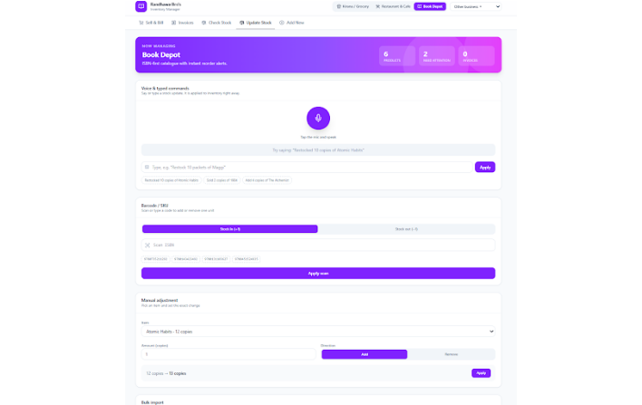
06 / HANDS-FREE INVENTORY
Natural Voice & Barcode Recognition
VOICE COMMAND EXAMPLE
"Restocked 10 copies of Atomic Habits"
Instant Parsing: Extracts product name, quantity, and action.
ISBN & SKU Scanner: One-tap stock in (+1) or stock out (-1).
Manual Override: Exact quantity adjustments anytime.

Slide 8

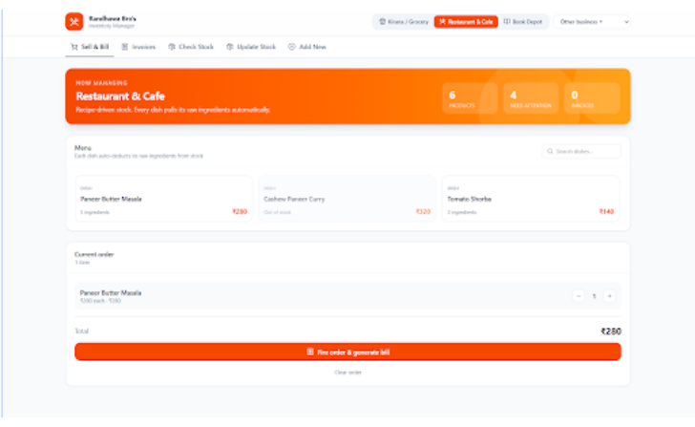
07 / SMART BILLING & RECIPES
Automated Recipe Deduction & Invoicing
Ingredient Mapping
One Paneer Butter Masala order deducts 5 raw ingredients automatically.
Live Dish Availability
Menu items auto-lock when core ingredients run out.
Fire Order & Bill
Single click generates GST invoice and updates kitchen stock.

Slide 9

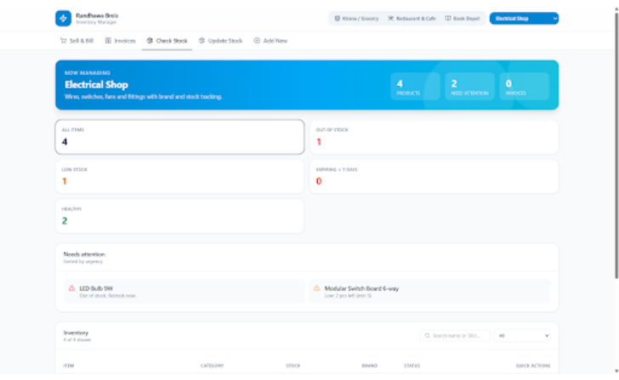
08 / REAL-TIME DIAGNOSTICS
Warnings Before It Is Too Late
Urgency Triage
Critical out-of-stock and low-stock items surface at the top.
7-Day Expiry Radar
Flags perishable items expiring within a week.
Healthy Stock Metrics
Instant visual breakdown of total catalog health.

Slide 10
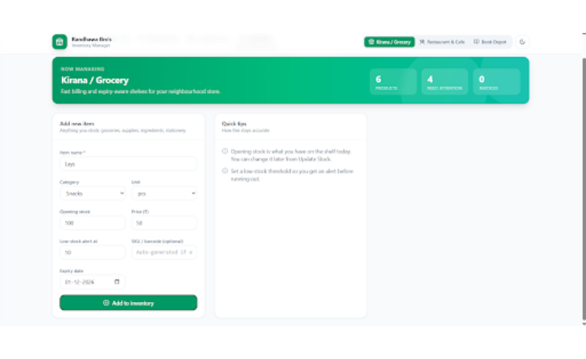
09 /SMART CATALOGING
Expiry-Aware Shelf Onboarding
Auto-Generated SKUs
Creates scannable codes automatically if none exist.
Custom Alert Thresholds
Set custom minimum stock rules per product.
Flexible Units
Track pieces, packets, kilograms, or liters seamlessly.

Slide 11


10 / AI ENGINE STACK
Powered by Next-Gen Foundation Models
Gemini 4 Argon
GPT 6 Luna
Claude 5.5 Sonnet
Real-time voice intent recognition.
Automated recipe ingredient deduction.
Dynamic UI and invoice generation.

Slide 12
BUILT BY RANDHAWA BRO'S
Ready for the Counter.
Empowering neighborhood businesses with voice-first inventory and one-tap billing.
Amrit Randhawa
Tranpreet Randhawa
CO-CREATOR & DEVELOPER
CO-CREATOR & DEVELOPER
THANK YOU · LIVE DEMO & Q&A

